Slide 1


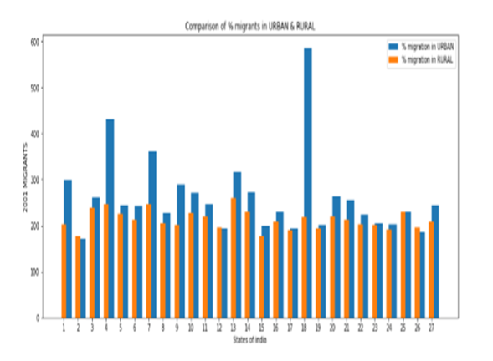
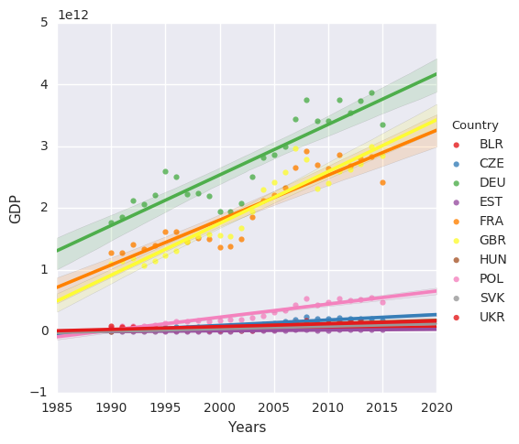
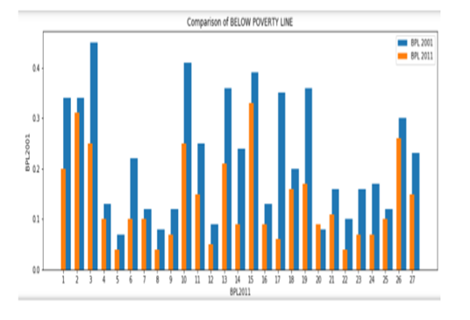
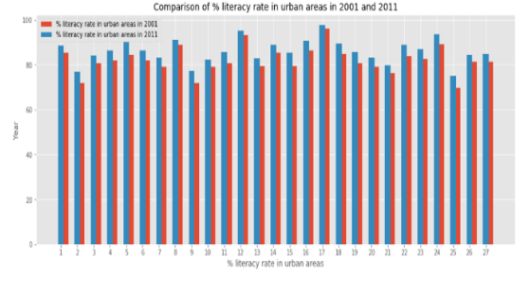
Analysis of Statistical Techniques for Sustainability of Indian States
Computational Data Analysis
Objective: The objective of the project is to analyse whether Indian States are Sustainable or not and check whether factors like Economic Growth, Poverty, Education impacts the sustainability of Indian states nowadays.
To check whether Labour Force, Life Expectancy, Social Sector Expenditure affects overall Poverty Level Estimates and also predict the future poverty trend.
check whether Labour Force, Annual Plan Figures and the state wise GDP affects overall Economic Growth and also predict the future Economies trend.
To check whether Birth Rate, Death Rate, Access to Basic Amenities affects overall Migration Estimates and also predict the future migration trend.
To check whether Literacy Rate, Poverty Rate, Number of Education Institutes and Dropout Rates affects overall Education and also predict the future education trend.
Concepts, Tools and Technologies
Libraries In Python
ANOVA Test
Matrix Rank
Time Series
Co-relation
METHODOLOGY :-
We defined our goal on which we had to work and started our analysis.
We started with data collection from various reports and websites, such as: niti.gov.in, Research Gate, Planning Commission Of India etc.
We also read some facts provided in the research papers and reports which helped in defining the objectives on which we had to work.
We prepared a yearly comparison of different BPL population, % Literacy Rate, % migrants in rural and urban areas in the graphs given below along with comparison of GDP between different countries.
Then by applying various statistical methods on a set of datasets. We were able to reach certain results that did clarify some of the facts provided.
Conclusion: From the results we can clearly see, that there is an increase in the below poverty line population from the year 2001-2011 also a similar result can be seen in the state wise data provided in the percentage of migrants present in urban and rural areas. The net percentage literacy rate has fluctuated only by a minor degree from 2001 to 2011.We got all this result from the various statistical methods like correlation, Matrix Ranking, ANOVA to predict the interrelation of data. All the above parameters we discussed are very important factors which can be used to analyze and differentiate data to carry out a comparative analysis. With the rise of factors such as Population, Quality Education and Poverty the overall Sustainability of a state get affected. Finally, we can conclude that in the coming years these parameters and many more will play a very important role in the economic growth of different countries in the future.

